Slide 1

Theory and Applications of Time Series Analysis
Group-05(C3)
Group Members
VIVEK SHARMA(2104161)
TUSHAR SHELKE(2104162)
OM SHETE(2104163)
SHIRISH SHETTY(2104164)
SANFORD SHILESH(2104165)

Slide 2
Introduction
Time series analysis is a statistical technique that deals with data points collected over time.
Time series analysis is important in many fields, such as finance, economics, meteorology, and engineering, where understanding trends and patterns in data is essential.
Key terms in time series analysis include autocorrelation, stationarity, seasonality, and trend.

Slide 3
Data Collection And Pre Processing
Data collection for time series analysis can be done in various ways, such as direct measurement, surveys, or data archives.
Time series data may contain missing values, outliers, or noise, which require preprocessing techniques such as imputation, filtering, and smoothing.

Slide 4
Time Series Models
Time series models can be classified into three categories: autoregressive (AR) models, moving average (MA) models, and autoregressive integrated moving average (ARIMA) models.
AR models describe how the current value of a time series depends on its previous values.

Slide 5
Forecasting
Forecasting involves using time series models to predict future values of a time series.
The simplest method of forecasting is the naive method, where the next value is assumed to be equal to the previous value.
More sophisticated forecasting methods include exponential smoothing, ARIMA models, and seasonal decomposition.

Slide 6
Exploratory Data Analysis
Exploratory data analysis involves visualizing and summarizing the time series data to identify patterns, trends, and relationships.
Visualization techniques include time plots, seasonal plots, and correlograms

Slide 7
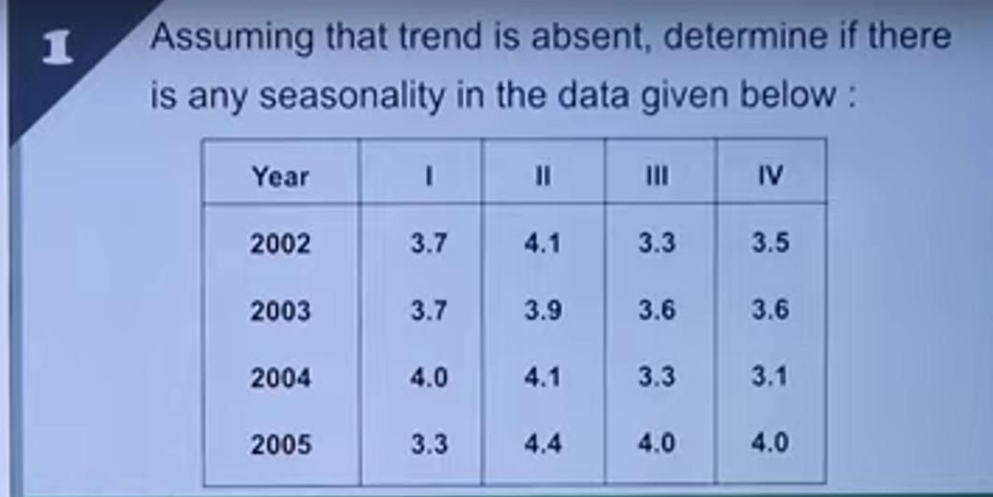

Slide 8
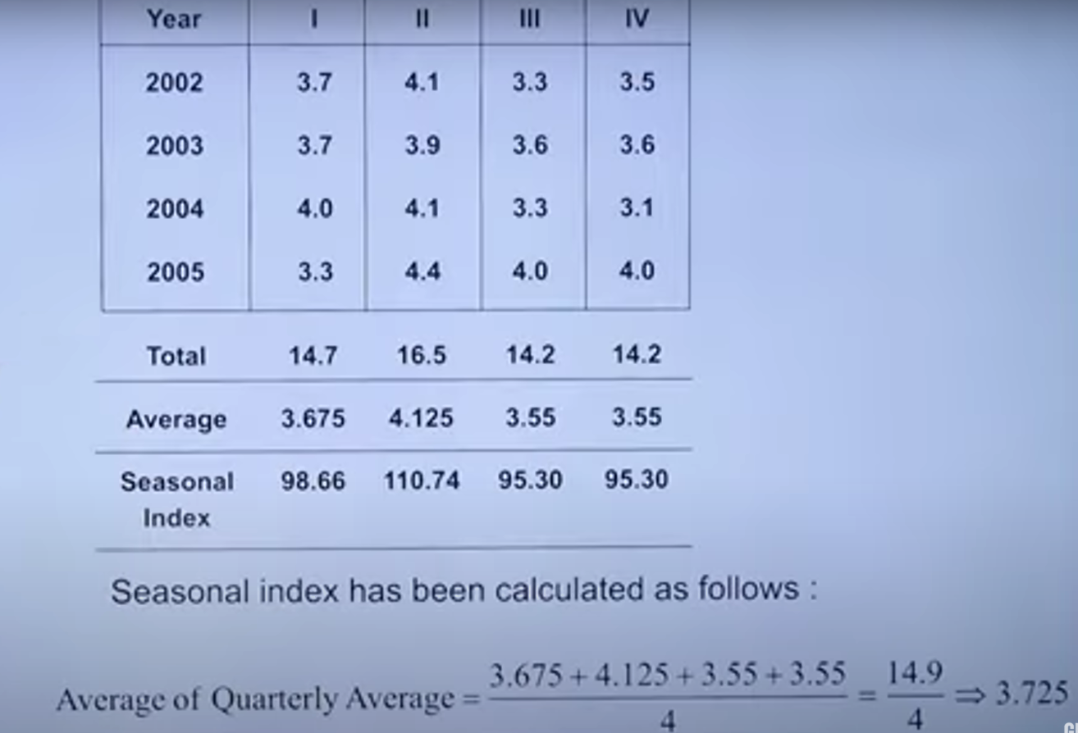

Slide 9
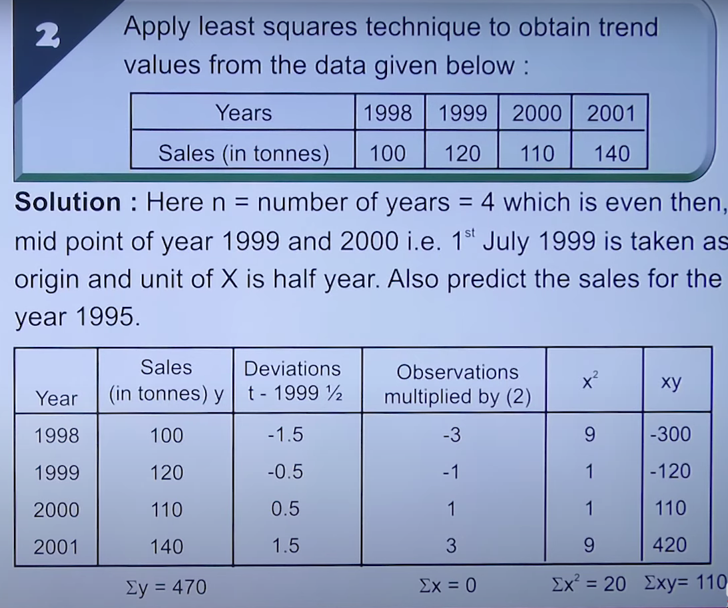

Slide 10
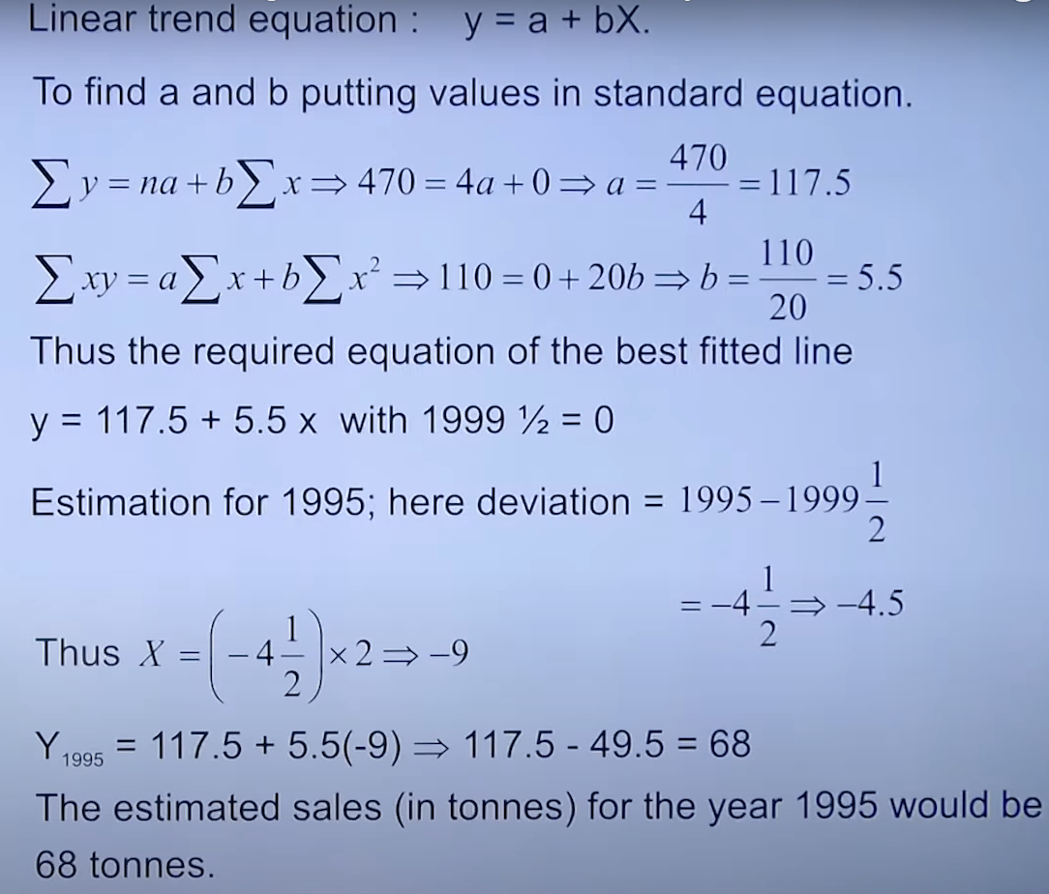

Slide 11
Applications of Time Series Analysis
Financial Forecasting: Time series analysis is commonly used in finance to predict stock prices, exchange rates, and other financial metrics. It helps investors, traders, and financial institutions make informed decisions about buying, selling, and managing assets.
Demand Forecasting: Time series analysis is used in supply chain management and marketing to forecast demand for products and services. It helps businesses optimize inventory levels, production schedules, and pricing strategies to meet customer demand efficiently.
Anomaly Detection: Time series analysis is used to detect anomalies or outliers in data, such as identifying fraudulent activities in financial transactions, monitoring abnormal behavior in network traffic, and identifying anomalies in medical sensor data for early disease detection.

Slide 12
Applications of Time Series Analysis
Resource Planning: Time series analysis is used in operations management to optimize resource allocation, such as workforce scheduling, energy consumption, and transportation planning. It helps businesses and organizations make data-driven decisions to optimize resource utilization and minimize costs.
Climate and Weather Forecasting: Time series analysis is used in meteorology to forecast weather patterns, such as temperature, precipitation, and wind speed. It helps in predicting severe weather events, such as hurricanes, tornadoes, and floods, and supports decision-making for disaster preparedness and response.
Health Monitoring: Time series analysis is used in healthcare for monitoring patient vital signs, disease progression, and treatment outcomes. It helps in early detection of health issues, personalized medicine, and improving patient care.

Slide 13
Conclusion
Time series analysis is a powerful technique that has numerous applications in various fields. It helps in extracting valuable insights from time-based data, leading to better decision-making, improved operations, and enhanced forecasting capabilities.

